Slide 3
UCC Congregations and Members
Notes:
At the end of 2016, there were 5,000 congregations in the United Church of Christ with a total of 880,383 members. Overall, the membership of the UCC represented less than one percent (0.6%) of total U.S. congregational membership and was concentrated in the Great Lakes, Middle Atlantic, and New England regions of the country. In determining congregational statistics by state, 11.8% of all UCC congregations were located in Pennsylvania, which reported the greatest number of congregations. In total, the top five states with the most congregations contained over one-third (37.6%) of all UCC congregations.

Slide 4
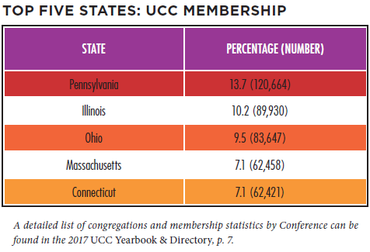
UCC Congregations and Members
Notes:
Membership was concentrated largely in Midwestern / Northern and New England states with 47.6% of all UCC members in five states alone. Not all states with the greatest number of churches possessed the greatest number of members, however. For example, only 4.7% of all UCC congregations were located in Connecticut; but more members were reported in this state (62,421) than in New York (31,494) even though New York reported more congregations. This indicates that average church membership was greater in Connecticut than in New York.

Slide 5
Growth and Decline
Notes:
Similar to other Protestant denominations, the UCC has experienced a decline in the numbers of congregations and members in recent decades.
From 2005 to 2015 alone, the UCC encountered a net loss of 601 congregations and 315,082 members. Some of this decline, however, began prior to the formation of the denomination in 1957 as the number of congregations steadily decreased despite membership increases in the UCC’s early years. In 2016, 43 congregations were removed from denominational records. Despite this decrease, congregational decline has slowed in recent years. From 2005 through 2007, the UCC experienced a loss of nearly three congregations per week on average (mostly as a result of General Synod’s resolution regarding same-sex marriage). In the past year, however, only one congregation was eliminated from denominational records every 1 1/4 weeks. Inversely, 12 congregations were added to denominational records in 2016. In total, 83 congregations received standing and were added to the UCC over the last five years. In this same time period, a new congregation (a church that received standing, affiliated, or merged with another congregation) was added about every three weeks.

Slide 6
Membership Growth and Decline
Notes:
In general, the number of members removed each year exceeds the number of members added for that same time period. Members are removed
from denominational records for a number of reasons including death, transfer of membership to another denomination, or updating of local
church membership records. The difference between UCC members added and removed was greater in 2016 than in 2015. In 2016, 20,406 members were added and 42,173 members were removed, with a net loss of 21,767 members. In 2015, there was a net loss of 19,625 members. (Note that net loss figures represented here are different than figures represented in the UCC Yearbook & Directory, which are based on total membership.) Over time, addition and removal differences have fluctuated; but both have decreased steadily as total membership has decreased.

Slide 7
Congregations by Race/Ethnicity
Notes:
A significant majority of congregations in the UCC self-identify as White/Euro-American (meaning that most members of a congregation belong
to that particular racial/ethnic group). Over time, however, the UCC as a whole is becoming more racially/ethnically diverse. Over the last decade,
the percentage of primarily White/Euro-American congregations decreased from 89.5% in 2006 to 85.9% in 2016; and the percentage of
Bi-Racial/Multi-Racial and Other congregations increased from 1.4% in 2006 to 4.6% in 2016. In addition, the percentage of Asian/Pacific Islander
congregations increased to 3.9% in 2016 from 3.0% in 2006. One cause of this shift over time may be due to the fact that the majority of congregations that close, merge, or disaffiliate with the denomination are primarily White/Euro-American congregations, thus decreasing their overall percentage. This is also coupled with the fact that newer UCC congregations tend to be more racially/ethnically diverse.

Slide 8
Congregations by Date of Organization
Notes:
While the UCC has only been in existence since 1957, many of its congregations were founded by predecessor denominations. Over two thirds
of churches (69.0%) were organized before 1900. Two out of ten congregations(21.0%) were organized between 1900 and 1969, and one in ten
(10.0%) were organized in the last 45 years. Over time, the percentage of the UCC’s newer churches is slowly increasing while the percentage of
older churches is slowly decreasing.

Slide 9
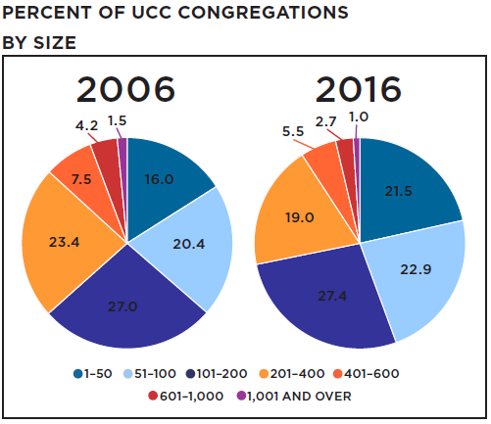
Congregation Size by Membership
Notes:
Nearly three in ten UCC members (29.8%) belong to congregations of 201-400 members, and this figure did not change significantly over the past decade. An increased percentage of UCC individuals held membership in smaller churches over this same time period, however, with 35.6% of all members attending congregations with 200 or fewer members in 2016 compared to 27.2% of all members in 2006. This trend is expected to continue in future years. As a result, percentages of smaller membership UCC congregations increased over the past decade. Four in ten congregations (44.4%) reported a membership of 100 or fewer, compared with 36.4% in 2006. Congregations with 101-200 members increased slightly since 2006, from 27.0% to 27.4%.

Slide 10
Worship Attendance
Notes:
When considering worship attendance figures rather than membership size, even more congregations are categorized as smaller churches. In
2016, eight in ten churches in the UCC (82.6%) had a weekly worship attendance of 1–100, a 9.4% increase from 2010 and a 34.5% increase from 2000. Over time, the percentage of congregations with greater worship attendance numbers has decreased steadily, with the most dramatic decreases occurring in congregations of 101–400 worship attenders since 1995. As a result, nearly half (49.0%) of all UCC congregations now have a weekly worship attendance of 1–50 individuals.

Slide 11
Worship Attendance and Membership
Notes:
The relationship between worship attendance and membership is shifting incrementally over time. From 1995 to 2016, decreased percentages
of people attended worship when compared to total congregational membership, except for the smallest membership congregations. On
average, 73.4% of a 1–50 member congregation’s total membership attended worship on a weekly basis in 1995. In 2016, an average of 83.4% of members attended weekly worship for the same size congregation. Overall, a greater percentage of members regularly attend worship in smaller congregations when compared with larger congregations, which suggests that the nature of relationships in smaller versus larger congregations may affect overall participation rates.

Slide 12
Christian Education/Faith Formation
Notes:
Since the 1950s, enrollment and attendance numbers for Christian Education/Faith Formation programming (also known as Church School
or Sunday School enrollment in previous years) has been declining along with membership numbers. While this decline is not surprising,
it is interesting to note that overall participation/enrollment rates, when computed as a percentage of total membership, have decreased
significantly from the 1950s and 1960s but has not changed dramatically in the last several years. Currently, percentages indicate that roughly two
out of every ten people in the UCC (19.5%) participated in these types of programs in 2016, at least in the traditional sense.

Slide 13
Christian Education/Faith Formation
Notes:
When comparing participation/enrollment with average weekly attendance figures, even fewer children and adults participated in Christian Education/Faith Formation programs on a regular basis. The gap between enrollment and attendance has increased incrementally over
time, meaning that smaller percentages of total participants in Christian Education/Faith Formation programs are attending these programs on a
weekly basis. These patterns matched average weekly worship attendance patterns, which have also decreased over time. In general, adult Faith Formation programs were attended more regularly than children/youth programs. This may be due to a number of factors including competing interests for young people’s attention on Sunday mornings, the overall decline in numbers of younger people in congregational life, and increases in the diversity of family situations around divorce and co-parenting.

Slide 14
Congregational Designations
Notes:
In the past decade, there was a 106.8% increase in the number of Open and Affirming (ONA) congregations in the United Church of Christ, from 671 churches (12.2% of all UCC churches in 2006) to 1,388 churches (27.8% of all UCC congregations in 2016). The majority of congregations that were identified as ONA tended to be organized prior to 1940 since the majority of all UCC congregations were organized in this time period as well; however, it is important to note that greater percentages of newer congregations were identified as ONA compared with older congregations. For example, nearly four in ten (38.8%) congregations that organized since 1970 were identified as ONA. Older congregations organized prior to 1970 were less likely to be ONA (26.5%). Roughly eight in ten (84.1%) congregations self-identified as being accessible to individuals with disabilities. While the specific types and degrees of accessibility among these congregations were not known, it is interesting to note that congregations organized before 1970 identified as accessible at greater percentages (85.6%) than congregations organized since
1970 (71.7%).

Slide 15
Congregational Outreach
Notes:
Reporting statistics indicated that an average of 909 community members was impacted by each local church’s outreach activities and initiatives in
2016. As expected, larger congregations reported greater numbers. The total sum of community members engaged in 2016 was 1,514,812 with 31.3% of all congregations reporting (including new/proposed congregations), which was a 97.5% increase from 2014 (766,719 engaged with 22.4% of congregations reporting), the first year that this category was included in annual church reporting. The significant increase was due most likely to increased familiarity with, and awareness of, this reporting category by local churches.

Slide 16
Mission/Immersion/Service Trips
Notes:
Since 2014, congregations have been asked to report whether members of their congregation participated in a U.S. or international mission/immersion/ service trip. In 2016, 494 (9.7%) congregations reported that members had participated in these types of trips (including new/proposed congregations). This was an increase from 2014 when 416 (8.1%) congregations reported trip participation.

Slide 17
UCC Authorized Ministers
Notes:
As of December 31, 2016, there were a total of 7,086 active (non-retired) Authorized Ministers in the United Church of Christ (Ordained, Licensed, Commissioned, Dual Standing, and Ordained Ministerial Partner Standing). Ordained Ministers were the largest percentage of active ministers
reported (82.9%); and Licensed Ministers comprised the second largest group of Authorized Ministers (9.3%). Seven ministers also hold standing
in the Congregational Christian Church.

Slide 18
Summary of UCC Authorized Ministers
Notes:
At the end of 2016, 9,897 Ordained Ministers in Full Standing were reported, including Retired Ministers and Pastor Emeriti. Of those 9,897
Ordained Ministers, nearly one-half (48.5% or 4,797) were employed, with 71.4% (3,427) of those employed actively serving in a local church (either a UCC church or non-UCC church). Four out of ten (40.7% or 4,029) were Retired Ministers or Pastor Emeriti, and 10.8% (1,071) were unclassified (ministers who did not hold a position at the time of Yearbook production or whose position had not been reported at that time) or were on a leave of absence. See Appendix for a detailed summary of Ordained Ministers by classification. Over the last 30 years (1985 to 2015), Ordained Ministers decreased in number by a net total of 113 (-1.1%). While currently employed Ordained Ministers decreased by nearly one third in the last three decades (-30.5%), unclassified / leave of absence Ordained Ministers increased by nearly one half in the same time period (+49.2%).

Slide 19
Trends in Ordained Ministry
Notes:
Since 1990, the number of Ordained Ministers has remained relatively stable, though there are slight incremental decreases in more recent years. In addition, the number of Retired Ministers and Pastor Emeriti has increased steadily. Interestingly, in this same time period, the number of Ordained Ministers serving in local congregations decreased at steadily similar rates due to overall congregational and membership decline. If past trends continue, which are predicted to be the case, there will be no clergy supply shortage in future years, even though retirements continue to increase.

Slide 20
UCC Authorized Ministers by Age
Notes:
Statistical information regarding Authorized Ministers in the denomination reflects an increasingly aging population. When all active (nonretired)
Authorized Ministers were considered, over one half were age 60 and above (54.8%) and over one-fourth were 50-59 (26.1%), making 80.9%
of all active ministers age 50 and over. When measuring changes over time, the percentage of local church pastors and co-pastors under 60 decreased in the last twelve years from 67.6% in 2004 to 48.3% in 2016, while pastors and co-pastors 60 and over increased significantly (from 28.4% in 2004 to 51.7% in 2016).

Slide 21
UCC Authorized Ministers by Race/Ethnicity
Notes:
The majority (87.8%) of all active, non-retired UCC Authorized Ministers identified as White/Euro-American, with 12.2% identifying as non-white.
Among the various types of authorization, Ministers with Dual Standing were the most racially/ethnically diverse group with three in ten (32.1%) ministers listed as non-white. Commissioned Ministers and Ministers with Ordained Ministerial Partner Standing were the least racially/ethnically diverse authorization groups, with no Asian/Pacific Islander, Native American, or Bi-Racial/Multi-Racial ministers listed within denominational records.

Slide 22
UCC Ordained Ministers in Local Churches by Race/Ethnicity
Notes:
Regarding racial/ethnic representation in local church pastor positions, active, non-retired White/Euro-American Ordained Ministers were over-represented in all positions except for the role of associate/assistant pastor. For example, while only 88.9% of all UCC Ordained Ministers identified as White/ Euro-American, they constituted 90.7% of all pastors (including senior pastors). Interestingly, there is significant over-representation in associate/assistant pastor roles by African-Americans (17.0% representation compared with 7.3% overall representation) and Hispanics/Latinos (1.9% representation compared with 1.1% overall representation).

Slide 23
UCC Authorized Ministers by Gender Demographics
Notes:
In total, approximately 50.3% of active, non-retired Authorized Ministers in the United Church of Christ identified as male, 49.6% identified as female, and 0.1% identified as transgender/gender-variant. For the first time in history, however, the percentage of active, non-retired female Ordained Ministers (50.5%) exceeded the percentage of active, non-retired male Ordained Ministers (49.4%) in 2016. In general, there were more Licensed, Dual Standing, and Ordained Ministerial Partner Standing ministers who identified as male; but there were nearly four times as many female Commissioned Ministers when compared to males.

Slide 24
UCC Ordained Ministers in Local Churches by Gender
Notes:
The percentage of active, non-retired female Ordained Ministers serving in local church pastor positions has increased significantly over time, from
31.9% in 2005 to 45.1% in 2016. Four in ten (40.0%) local church pastors (including senior pastors) identified as female in 2016, compared with 30.2% in 2005. Over half (55.2%) of co-pastors, half (52.7%) of interim/designated-term/supply pastors, and over two-thirds (70.5%) of associate/assistant pastors identified as female.

Slide 25
Ordinations and MIDs
Notes:
The number of ordinations per year decreased over the past decade from 221 in 2007 to 129* in 2016. Throughout this time period, the 2011-2015 annual average of ordinations was 160 compared to the 2006-2010 annual average of 180 ordinations. When reviewing trends over the past several decades, however, ordination numbers fluctuated in similar ways; and it is yet to be seen whether this recent decrease signals a continuing trend. As of December 31, 2016, there were 759 active Members in Discernment on record within the denominational database. Members in Discernment (or MIDs) were concentrated within larger Conferences, as is to be expected, with the Massachusetts, Illinois, Connecticut, and Ohio Conferences reporting 29.3% of the total number of MIDs. In terms of gender, females comprised 63.5% of all MIDs (a greater percentage than that of current female Authorized Ministers). Members in Discernment were also more racially/ethnically diverse than current Authorized Ministers with 22.7% identifying as non-white (compared with 12.2% of all Authorized Ministers identifying as non-white).

Slide 26
Local Church Financial Trends
Notes:
Operating expenses for an average local congregation in 2016 was $168,533, a $133 (+0.1%) average increase from 2015. Average total income for a local church in 2016 was $225,966, a $5,644 (-2.4%) average decrease from 2015. Both the average expenses and income for local congregations increased from average amounts reported over the past decade—from $147,714 in expenses (a 14.0% increase) and $201,446 in income ( a 12.1% increase) in 2006—indicating that expenses increased at a greater rate than income.
In 2006, Our Church’s Wider Mission (OCWM) giving represented 4.9% of total local church expenditures. This percentage decreased to 4.3% of total local church expenditures in 2016. Overall expenditures for congregations of the United Church of Christ increased from $912,804,952 to $920,012,927 in a period of four years (December 31, 2012 to December 31, 2016), a 0.78% increase. Interestingly, however, total amounts in all expenditure categories decreased from 2015 to 2016.

Slide 27
Stewardship and Mission Support
Notes:
Totals for wider church stewardship and giving by local congregations of the United Church of Christ decreased over the past several years; however, there were increases in the number of congregations participating in special offerings. For special offerings giving from local congregations, each offering experienced an increase in the percentage of participating congregations over the past decade, except for One Great Hour of Sharing which declined slightly. In 2006, 52.7% of churches participated in the Neighbors in Need offering; participation increased to 55.1% in 2016. Even more striking, 27.8% of congregations participated in the Strengthen the Church Offering in 2006; and in 2016, 41.2% participated in this offering, a 48.2% increase over the past decade.

Slide 28
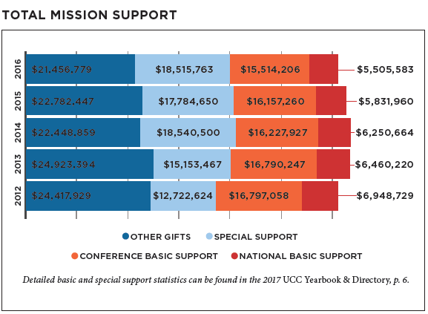
Stewardship and Mission Support
Notes:
In overall mission support, the total for 2016 decreased from the previous year by $1,563,986 (-2.5%). Conference and national basic support also decreased, but special support increased by $731,113 (+4.1%). Since 2012, national basic support and other gifts experienced the greatest decreases (-20.7% and -12.1%, respectively); and conference basic support decreased by 7.6%. Special support, however, experienced a significant increase since 2012 (+45.5%).

Slide 29
The Church Dollar
Notes:
In the last decade, the distribution of the church dollar experienced some noticeable shifts. Current local expenses increased by $.03, and capital expenses and other gifts each decreased by $.01 (with minor fluctuations from year to year). Special support and conference basic support remained the same, and national basic support decreased to less than $.01 on the dollar.

Slide 30
Special Report: Statistical Highlights on Global Ministries
Notes:
Data was collected from Global Ministries, a joint mission partnership of the United Church of Christ and the Christian Church (Disciples of Christ)
in order to learn more about the work being done with domestic and international partners. For the year 2016, 272 mutual partnership arrangements with various organizations and ministries were maintained between five regional offices across 81 different countries. For more information about mutual partnerships and ministries in specific regions, visit the Global Ministries website at www.globalministries.org.

Slide 31
Global Humanitarian and Development Ministries
Notes:
Funds collected from the One Great Hour of Sharing (OGHS) Special Offering and other special funds and endowments are used for humanitarian and sustainable development aid in working with mutual partners. Some of the larger multi-level partners include Church World Service, Action by Churches Together (ACT) Alliance, and the World Council of Churches. In 2016, the UCC national office distributed a total of $2,921,083 in program funding for refugees/migration (19.7% or $577,459), natural disaster response (32.3% or $943,968), and transformational development (48.0% or $1,399,656). The specific area that received the greatest percentage of funding was international natural disaster long-term response (22.5% or $657,573).
For more information, visit www.ucc.org/oghs.

Slide 32
Special Report: Statistical Highlights on CHHSM
Notes:
The UCC’s Council for Health and Human Service Ministries (CHHSM) is an association of 68 corporate members, nearly 60,000 employees and
400 member ministries—each founded by a UCC congregation, member or minister—and recognized by one of the UCC’s 38 Conferences. Services
provided by CHHSM organizations are categorized within one of five general areas: Primary and Acute Health Care Services, Services to Persons
with Disabilities, Services to Children, Youth and Families, Charitable Grant-Making Foundations, and Services to the Aging (the largest category).
CHHSM member organizations provide data annually on the impact
of their services, which are shared in the UCC Yearbook & Directory as
well as a more detailed Annual Report available at www.chhsm.org.

Slide 33
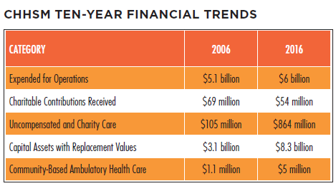
Financial Trends
Notes:
When looking at financial trends over the last decade, operating expenses for CHHSM organizations increased while receipt of charitable contributions decreased. Uncompensated/charity care totals increased significantly by $759 million from 2006 to 2016. Community based ambulatory health care also increased by $3.9 million from 2006 to 2016.

Slide 34
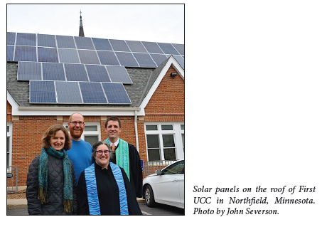
Special Report: Environmental Commitments of UCC Congregations
Notes:
A total of 89 churches in the United Church of Christ have at some point gone through a process to be recognized or certified for their environmental commitments. These churches have an average membership of 339 members, with some having as few as 24 members and others having as many as 1,656 members. In terms of regional location, 26 of the recognized churches are in the Connecticut Conference, 17 are in the Massachusetts Conference, 10 are in the Pacific Northwest Conference, and 9 are in the Penn Central Conference. In many cases, congregations were recognized by conference-level Green Church designations, but some are also recognized through non-profit programs such as Earth Ministry in Seattle and GreenFaith in New Jersey. In 2016, the United Church of Christ national setting revamped and renamed its own environmental recognition program which is now known as Creation Justice Churches. Seven congregations across the country have received this recognition.
In addition to recognition programs, churches in the UCC have manifested their environmental commitments in numerous other ways. As of August 15, 2017, 78 churches have community gardens; 71 churches have solar panels; and 41 churches have divested from fossil fuels.
Further information about the environmental commitments of UCC congregations can be found at www.ucc.org/environmental-ministries.

